Slide 1

ONLINE RETAIL SALES ANALYSIS

Slide 2

PROBLEM STATEMENT
The online retail store is performing well, but the management wants to understand the major contributing factors to their revenue to plan strategically for the next year. The leadership seeks insights from both an operations and marketing perspective, and wants to focus on areas that are performing well as they plan to expand the business.

Slide 3
1
Problem Statement
AGENDA
2
Data Analysis
3
Insights

Slide 4
DATA ANALYSIS
$2M
882K
418
Annual Sales
Quantity Sold
Customers

Slide 5
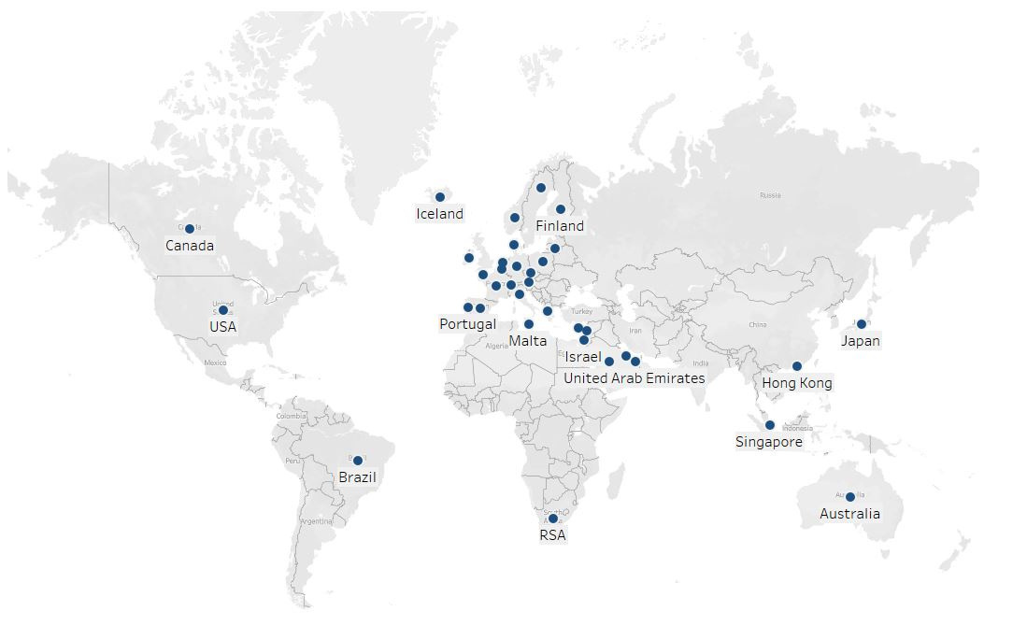
MARKET ANALYSIS

Slide 6
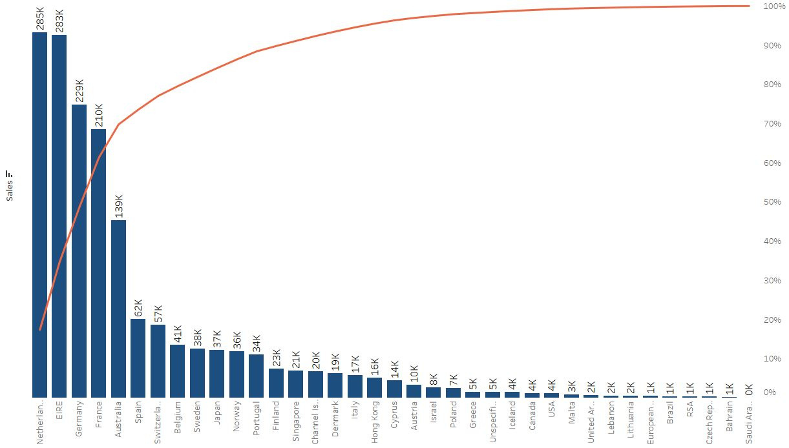
PARETO ANALYSIS
The Pareto analysis of country sales reveals that the majority of sales, 80%, are coming from Netherlands, Ireland, Germany, France, Australia, Spain, Switzerland, and Belgium.

Slide 7
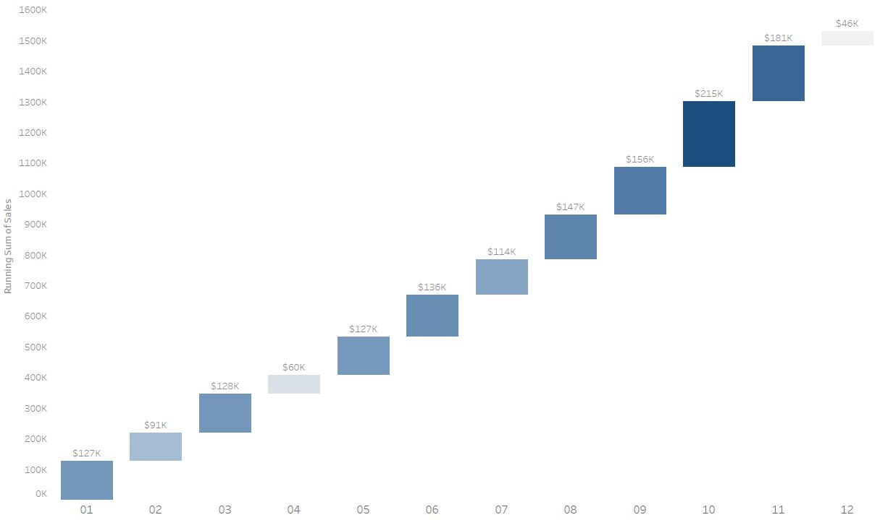
SALES FLOW
The months of September, October, and November have witnessed sales more than $150k.

Slide 8
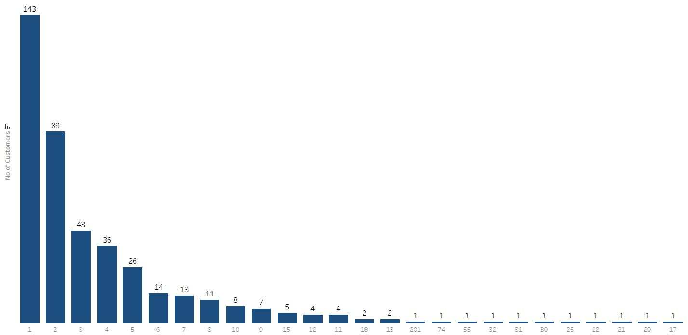
CUSTOMER REPEAT PURCHASE
Of the 418 customers, approximately 250 have made repeat purchases.

Slide 9
RFM ANALYSIS
Customer Segmentation
Best Customers
Big Spenders
Loyal Customers
Potential to become Best Customers
Look out Buyers
Occasional Buyers
Almost Lost Customers
Lost Customers
Lost Cheap Customers

Slide 10
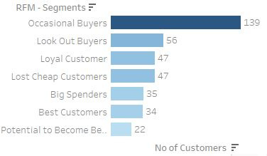
RFM ANALYSIS
1
The total customer base is 418, out of which the majority are occasional customers (139) followed by look out customers (56).
2
Only a small percentage of customers are classified as loyal customers (47) or big spenders (35).
3
The best customers category includes only 34 customers, which is a relatively small number compared to the total customer base.

Slide 11

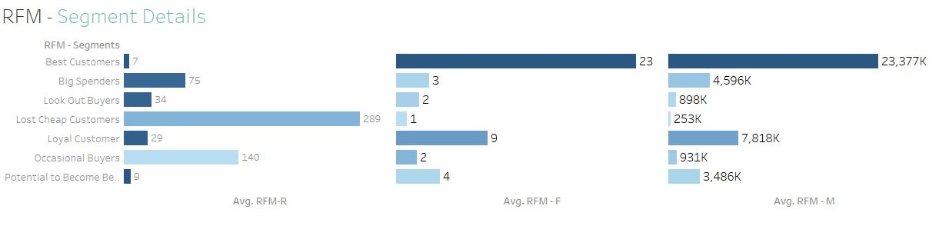
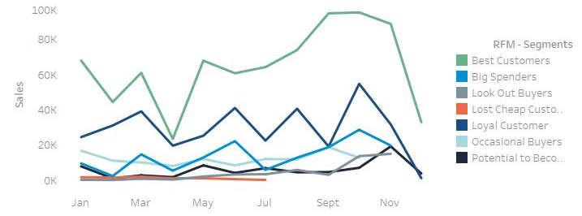
RFM ANALYSIS

Slide 12
1
The map illustrates that the majority of sales are concentrated in the European region, with minimal sales in the American region and even fewer sales in other regions.
2
The countries including the Netherlands, Ireland, Germany, France and Australia are generating high revenue.
INSIGHTS
3
The months of September, October, and November experienced higher sales compared to other months, indicating the presence of seasonality in this period.
4
Of the 418 customers, approximately 250 have made repeat purchases.
5
Overall, the customer base appears to be relatively diverse in terms of purchasing behavior, with a mix of high and low-value
customers, and both frequent and infrequent purchasers.

Slide 13

ANY QUESTIONS
THANK YOU

